Slide 1
UM EECS 270 F25
Introduction to Logic Design
13. Sequential Design Examples

Slide 2
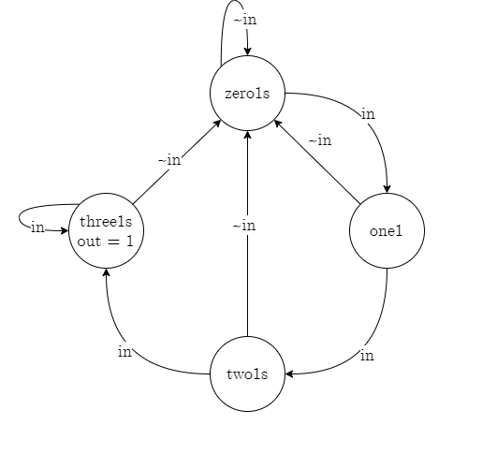
Sequence Detector in Verilog
State Table
S | in |  | out
 | 0 | 1
zero1s | zero1s | one1 | 0
one1 | zero1s | two1s | 0
two1s | zero1s | three1s | 0
three1s | zero1s | three1s | 1
 | S⁺
Transition Table
Q₁ Q₀ | in |  | out
 | 0 | 1
0 0 | 0 0 | 0 1 | 0
0 1 | 0 0 | 1 0 | 0
1 0 | 0 0 | 1 1 | 0
1 1 | 0 0 | 1 1 | 1
 | Q₁⁺ Q₀⁺
Transition List
S | Transition Expression | S⁺ | out
zero1s | ~in | zero1s | 0
zero1s | in | one1 | 0
one1 | ~in | zero1s | 0
one1 | in | two1s | 0
two1s | ~in | zero1s | 0
two1s | in | three1s | 0
three1s | ~in | zero1s | 1
three1s | in | three1s | 1
State Assignment
parameter zero1s parameter one1 parameter two1s parameter three1s | = 2’b00; = 2'b01; = 2'b10; = 2'b11;

Slide 3
Sequence Detector V1: assign
Transition Table
Q₁ Q₀ | in |  | out
 | 0 | 1
0 0 | 0 0 | 0 1 | 0
0 1 | 0 0 | 1 0 | 0
1 0 | 0 0 | 1 1 | 0
1 1 | 0 0 | 1 1 | 1
 | Q₁⁺ Q₀⁺
module SequenceDetectorV1(input clk, in, output out);
reg [1:0] Q;
initial Q = 2'b00;
// Next-state logic: assign
wire [1:0] D;
assign D[1] = in & (Q[1] | Q[0]);
assign D[0] = in & (Q[1] | ~Q[0]);
// State Update
always @(posedge clk)
Q <= D;
// Output logic
assign out = (Q[1] & Q[0]);
endmodule

Slide 4
Sequence Detector V1: always
Transition Table
Q₁ Q₀ | in |  | out
 | 0 | 1
0 0 | 0 0 | 0 1 | 0
0 1 | 0 0 | 1 0 | 0
1 0 | 0 0 | 1 1 | 0
1 1 | 0 0 | 1 1 | 1
 | Q₁⁺ Q₀⁺
module SequenceDetectorV1(input clk, in, output out);
reg [1:0] Q;
initial Q = 2'b00;
// Next-state logic: always
reg [1:0] D;
always @*
begin
D[1] <= in & (Q[1] | Q[0]);
D[0] <= in & (Q[1] | ~Q[0]);
end
// State Update
always @(posedge clk)
Q <= D;
// Output logic
assign out = (Q[1] & Q[0]);
endmodule

Slide 5
Sequence Detector V2
Transition List
S | Transition Expression | S⁺ | out
zero1s | ~in | zero1s | 0
zero1s | in | one1 | 0
one1 | ~in | zero1s | 0
one1 | in | two1s | 0
two1s | ~in | zero1s | 0
two1s | in | three1s | 0
three1s | ~in | zero1s | 1
three1s | in | three1s | 1
module SequenceDetectorV2(input clk, in, output out);
reg [1:0] Q, D;
initial Q = 2'b00;
// State Transitions
always @*
begin
case(Q)
zero1s: if (in) D <= one1; else D <= zero1s;
one1: if (in) D <= two1s; else D <= zero1s;
two1s: if (in) D <= three1s; else D <= zero1s;
three1s: if (in) D <= three1s; else D <= zero1s;
endcase
end
// State Update
always @(posedge clk) Q <= D;
// Output logic
assign out = (Q[1] & Q[0]);
endmodule

Slide 6
ModelSim Demo

Slide 7
Design a sequential circuit that monitors the condition of a patient in a hospital bed. The input to the circuit is a binary number n that ranges in value from 1 to 7 and indicates the patient’s condition. The expected value of n is 3, but values of 2 and 4 are not considered abnormal. A new value of n is sent to the monitor automatically every 5 seconds. If n goes below 2 or above 4 on two or more occasions, the monitor should activate an alarm at a nurse’s station. The nurse responds by administering medication to the patient and resetting the monitor. Construct a suitable state table and corresponding transition table for this circuit.

Slide 9
Design a single-input single-output sequential circuit that recognizes the 4-bit input sequence 1010 including overlaps.
For example,
input sequence 0 0 1 0 1 0 0 1 0 1 0 1 0 1 1 1 0
output sequence 0 0 0 0 0 1 0 0 0 0 1 0 1 0 0 0 0

Slide 10
Design a sequential circuit that compares two unsigned n-bit numbers X=x_{n-1} x_{n-2} . . . x₀ and Y=y_{n-1} y_{n-2} . . . y₀ applied serially starting with their most significant bits. The circuit should have two outputs z₁ and z₂ that indicate the result of the comparison according to the code:
z₂ z₁
0 0 X = Y
0 1 X > Y
1 0 X < Y

